Slide 1
Data Analytics Report and Executive Summary
Gooden, Nina S.
Western Governors University
Dr. William Sewell
December 23, 2022

Slide 2


Nina S. Gooden
WGU Student and director of strategy
B.S. in Marketing, Current Project: Database Architecture

Slide 3

Abstract and Introduction
Purpose: explore the sales data for Montgomery County of Maryland.
Create a time series model which will predict alcohol sales for the following quarter.

Slide 4
Content
​Intro to Time Series
Research Question and Hypothesis
Data Governance
Data Preparation
Challenges and Corrective Steps
Visualizations
Model Identification​
Model Analysis
4
CONTOSO ALL-HANDS

Slide 5
“What is a time series model and how does creating one help us?”
(Sai Ram, 2020)

Slide 6




Data Needs
A Clear Objective
No missing Data
AR and MA Parameters
Stationarity

Slide 7
Where is our data from?
Montgomery County, Maryland 2017-2020

Slide 8
No Missing Values
Data Challenges
Time series models are highly sensitive to missing values. As such, we had to fill values in two places.
Time/date column, using the average of like values
Item type column, manually with knowledge of the missing item
Created workable columns with the necessary data

Slide 9
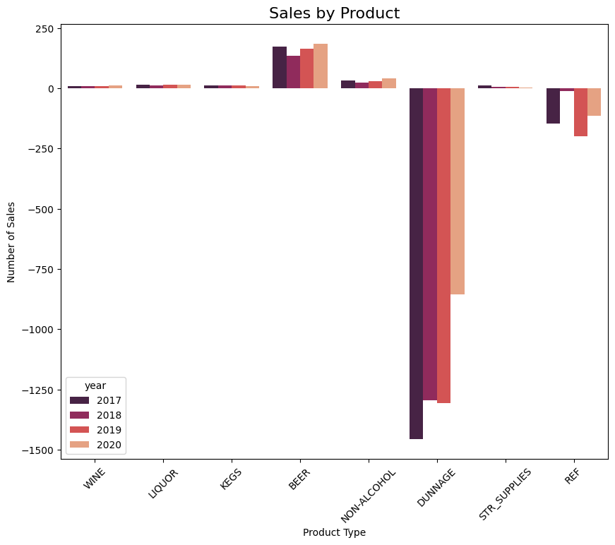
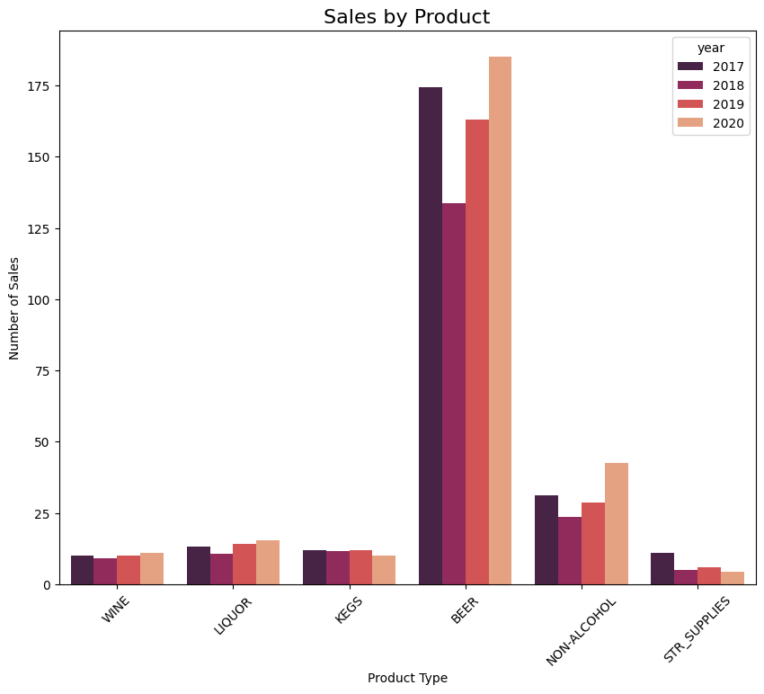

Item Type Evaluation
Item type was quickly eliminated as a deciding factor in the evaluation because Beer was overwhelmingly contributing to total sales. Item type could not be segmented out of the overall data without skewing the results.
The initial visualization found that there were quite a number of high-cost item types in the dataset.
They were removed to show just the highest contributors of the total sales.

Slide 10
Stationarity

Slide 11
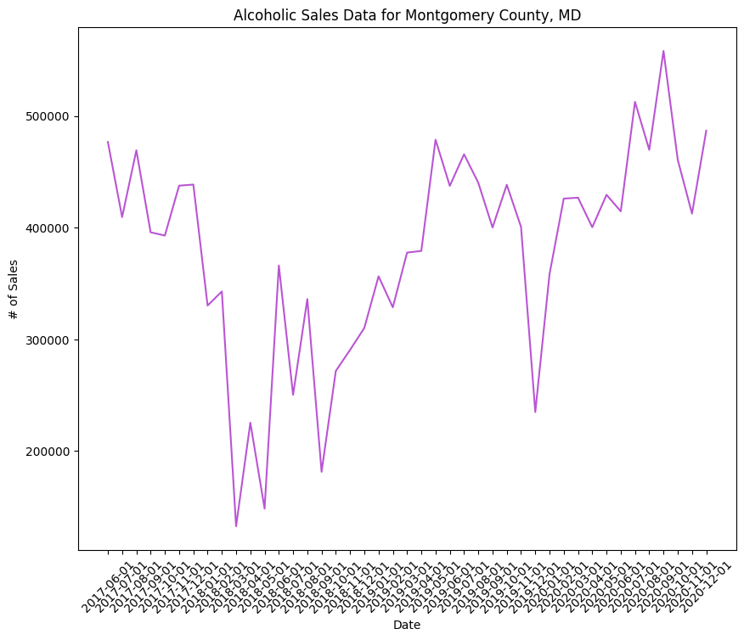
Is Our data stationary?

Slide 12
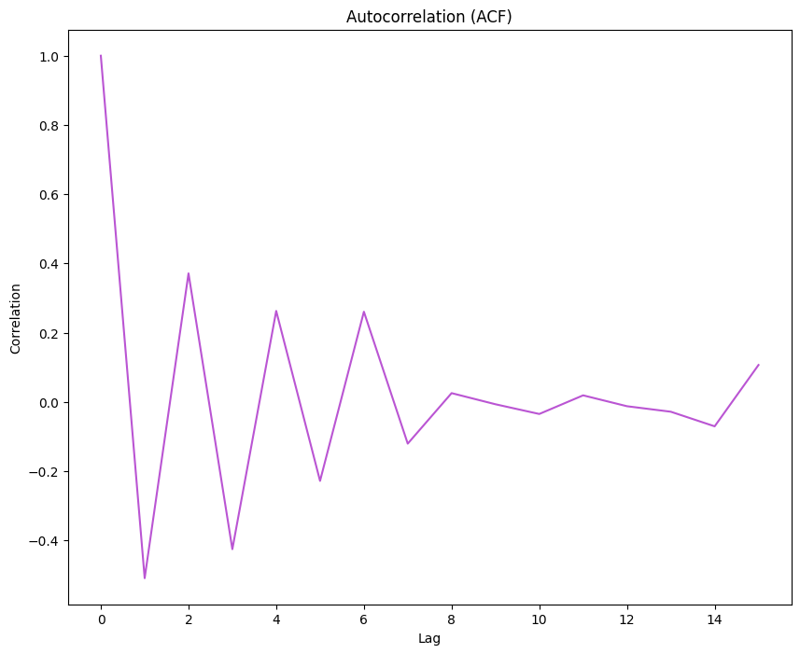
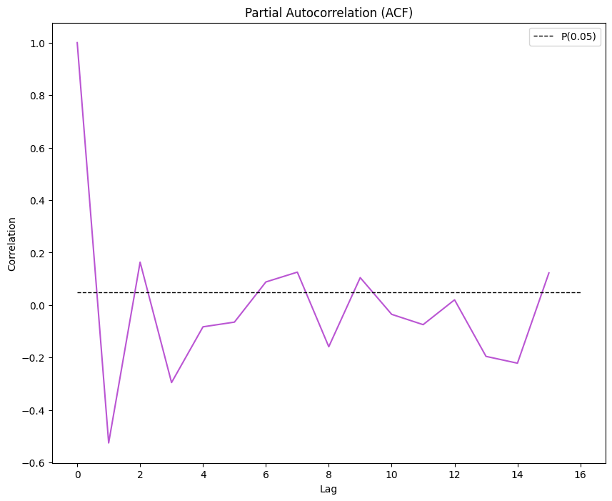
ACF and PACF Functions
The acf() function was applied to the train dataset in order to correlate the points of the dataset with a lagged version of itself.
The pacf() function was then applied to the train dataset in order to correlate the points of the dataset by each successive lagged term.
(Zvornicanin, 2022)

Slide 13
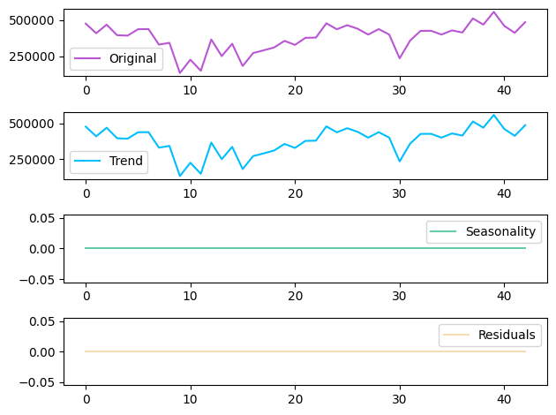
The seasonal decomposition is a useful and quick tool created to look at the trend, seasonality, and noise present in the dataset

Slide 14
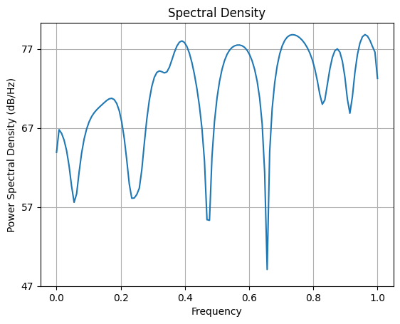
Power spectral density visual, created to mark power, strength, and frequency of data

Slide 15

Arima Modeling

Slide 16
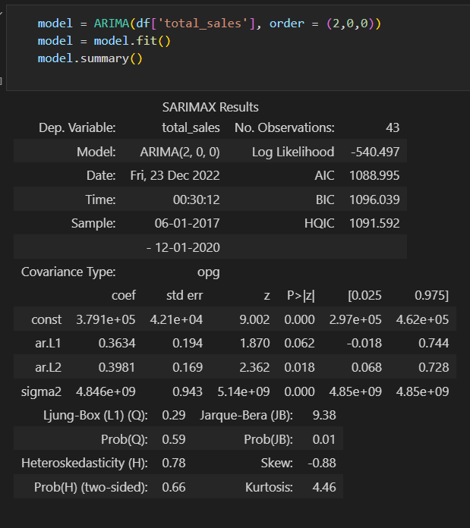
SARIMAX Results

Slide 17
Once the model is created, we split the data again and use the .predict() function to produce a prediction on the available data for accuracy comparison

Slide 18
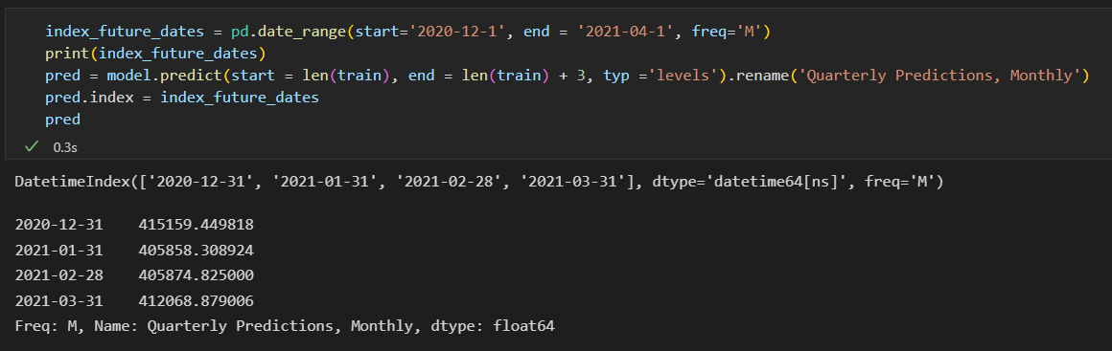
Research question: Quarterly Prediction

Slide 19
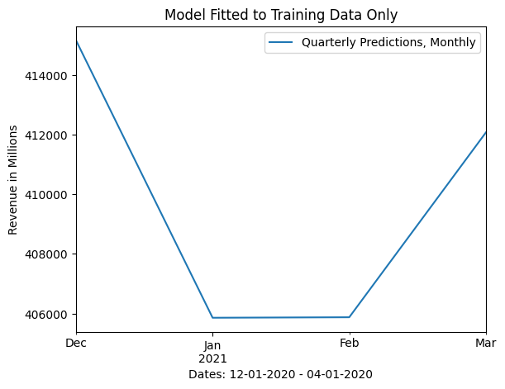
Success!

Slide 20



Limitations
Does not include price data for records
Revenue values are absent

Slide 21


Delimitations
Company names removed
Data security best practices

Slide 22

Data Summary and Implications
Though the overall trend in the data is steadily increasing, there is a considerable downturn approaching
The implication of this downward trend is that the county will suffer from sales loss at the beginning of the year.

Slide 23
Recommendations
That the county spend time leading up to this point to put in place processes and spending limits to lessen the impact of the revenue loss
It would also be beneficial for the county to record gains and losses for the missing dates so that the standard deviation information could be replaced with reality
This evaluation to be run on a quarterly basis to continue to reap the benefits of forecasting

Slide 24
References
Zvornicanin, E. (2022, November 8). Choosing the best q and p from ACF and PACF plots in ARMA-type modeling. Baeldung. https://www.baeldung.com/cs/acf-pacf-plots-arma-modeling
Sai Ram, K. (2020, February 28). Time Series Analysis and Forecasting: Novel Business Perspectives. AltexSoft. https://www.altexsoft.com/blog/business/time-series-analysis-and-forecasting-novel-business-perspectives/

